Slide 1
Using NLP to Predict the Likelihood of Certain Types of Negative Events Occurring with Medical Devices
Melinda Liu

Slide 2
Problem
International Consortium of Investigative Journalists (ICIJ) suspects more than 1.7 million injuries and nearly 83,000 deaths are being linked to medical devices.
ICIJ reports that the U.S. had more than 26,700 device recalls while India — with more than a billion people — had just 14 from 2013 to 2017.
Patients often are the last to be informed about malfunctioning devices.

Slide 3
Benefits of Project
Help medical practitioners make better decisions on which medical devices to use with the most minimal of risks.
Allows patients to be better informed on which medical devices they want to receive.
Give indications to manufacturers on how to better design medical devices with reduction to injury and mortality.

Slide 4
Aim of Project
Identify and study factors via unsupervised learning that influence certain types of negative events that occur with medical devices.
Plan: An unsupervised prediction model using NLP would be created to predict whether a medical device will issue a recall, a safety alert, a field safety notice, or a combination of two or more of them.

Slide 5
Data
International Medical Devices Database
Open Database License
Contents under Creative Commons Attribution-ShareAlike license
Download Link: https://medicaldevices.icij.org/p/download

Slide 6
Data Merging and Cleaning
Merged in outer join fashion the datasets from devices-1562662526.csv, events-1562662544.csv, and manufacturers-1562662522.csv
Text from reason column were lowercased and stemmed with the non-alphabetical text, whitespaces, and stop words removed and denoted to new column called clean_reason
df_final dataset: device_id (ID of the device), device_name (name of device), device_country (country where device was created), event_id (ID of event), action_classification (event risk class), event_country (country where the event took place), reason (textual reasons device is under investigation or reported), type (event type), and clean_reason (cleaned text under reason column)

Slide 7
Initial Findings

Slide 8
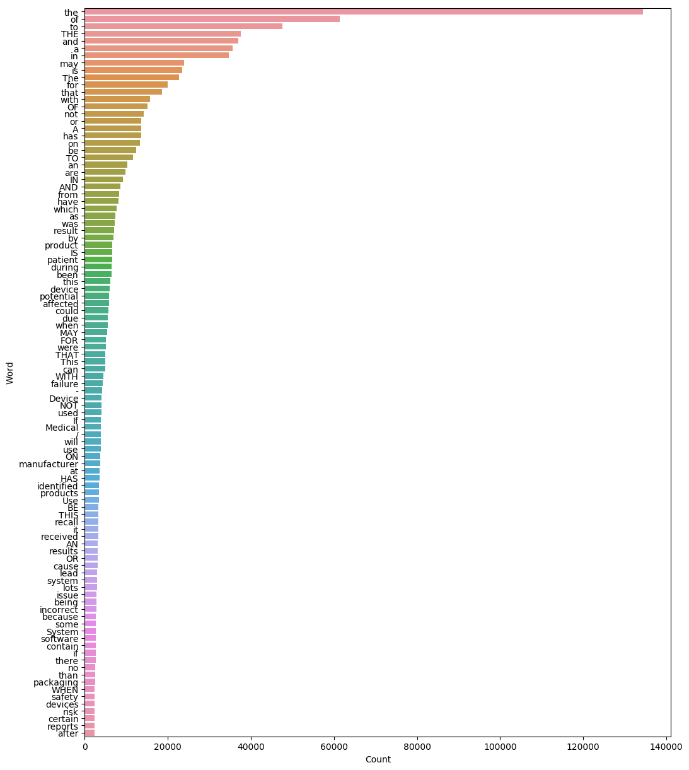
Figure 1: 100 Most Frequent Words of "reason" in df_final

Slide 9
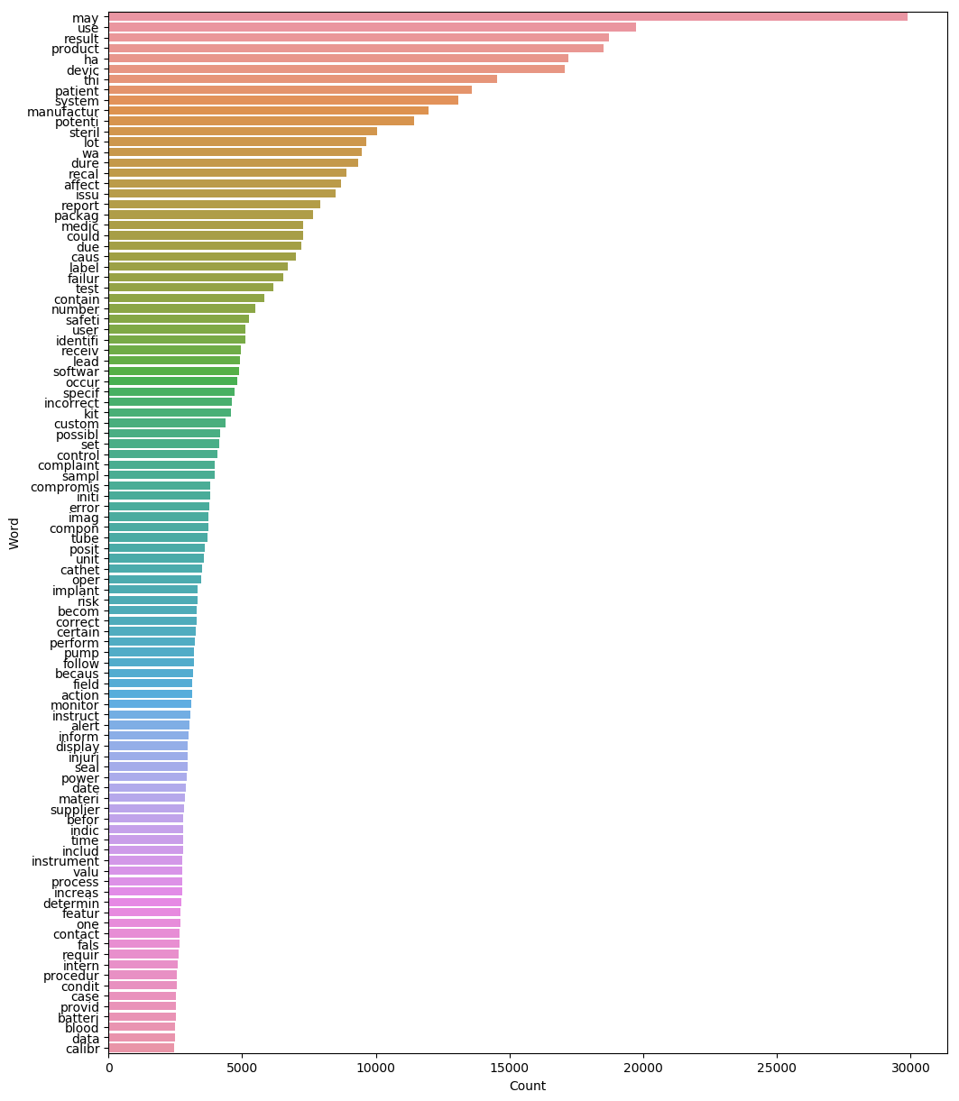
Figure 1: 100 Most Frequent Words of "reason" in df_final
Figure 2: 100 Most Frequent Words of "clean_reason" in df_final

Slide 10
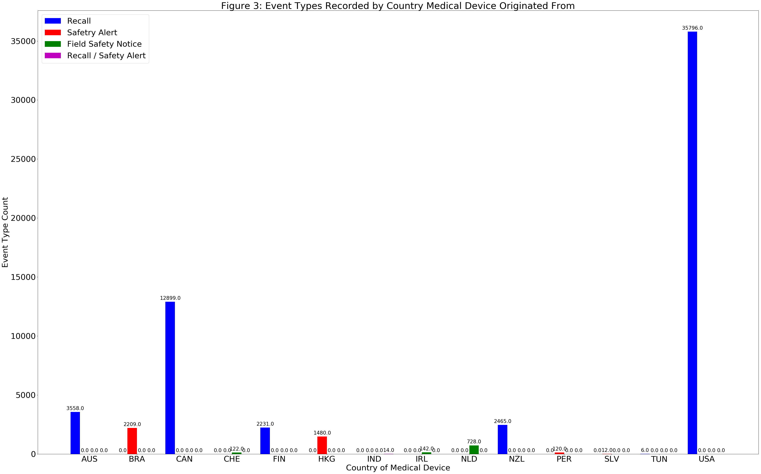
Initial Findings

Slide 11
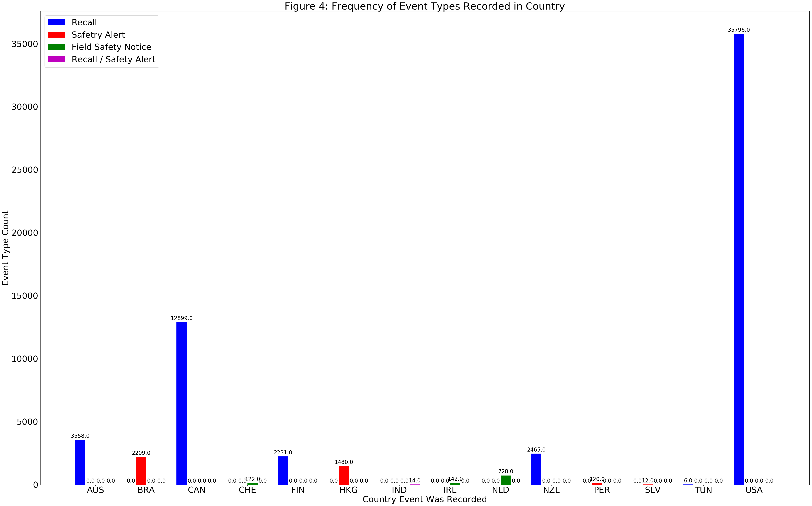
Initial Findings

Slide 12
Statistical Data Analysis
K-Means clustering and Singular Value Decomposition (SVD)
K-Means clustering handles big data well due to its linear time complexity.
SVD is popular in the field of natural language processing (NLP) to create a representation of the large yet sparse word frequency matrices.

Slide 13
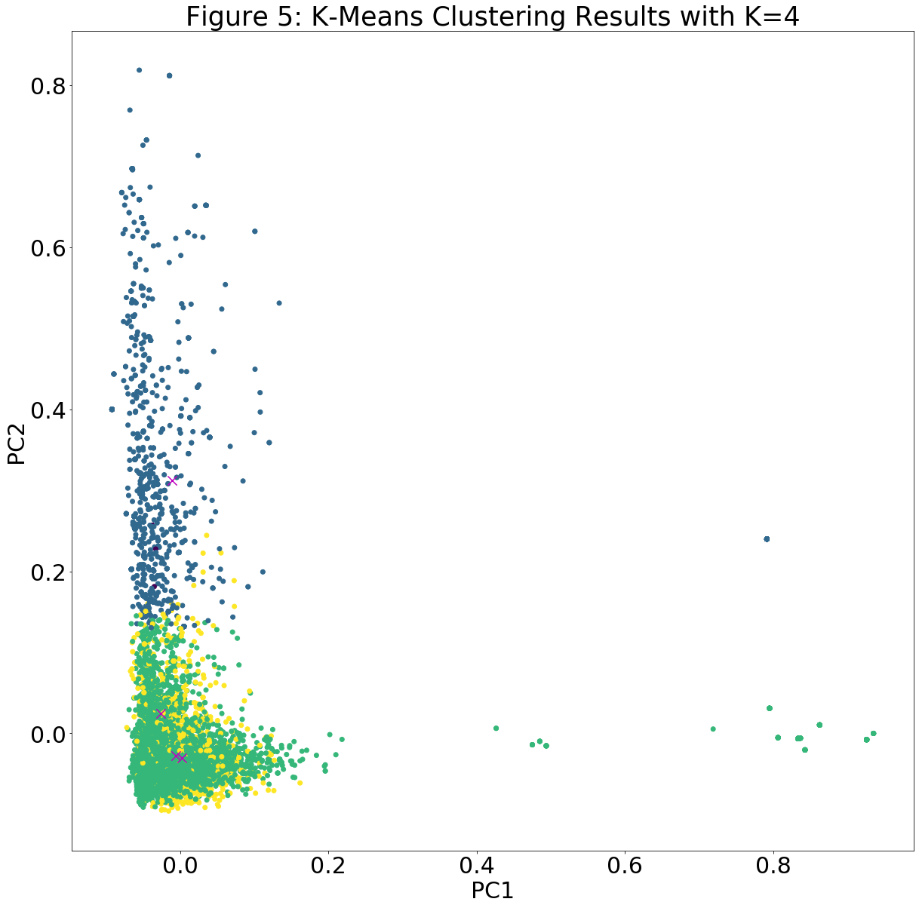

Slide 14
K-Means inference
Homogeneity Score
Ranges between 0 and 1 where 1 stands for perfectly homogeneous labeling
Calculated Score: 0.129
Indicates that labeling of the text data under the clean_reason column based on the discrete values of the type column is not very homogenous.
Silhouette Coefficient
Best value is 1 while worst value is -1
Values near 0 indicate overlapping clusters
Calculated Value: 0.006
Indicates the clusters very much overlap rather than being distinct from each other.

Slide 15
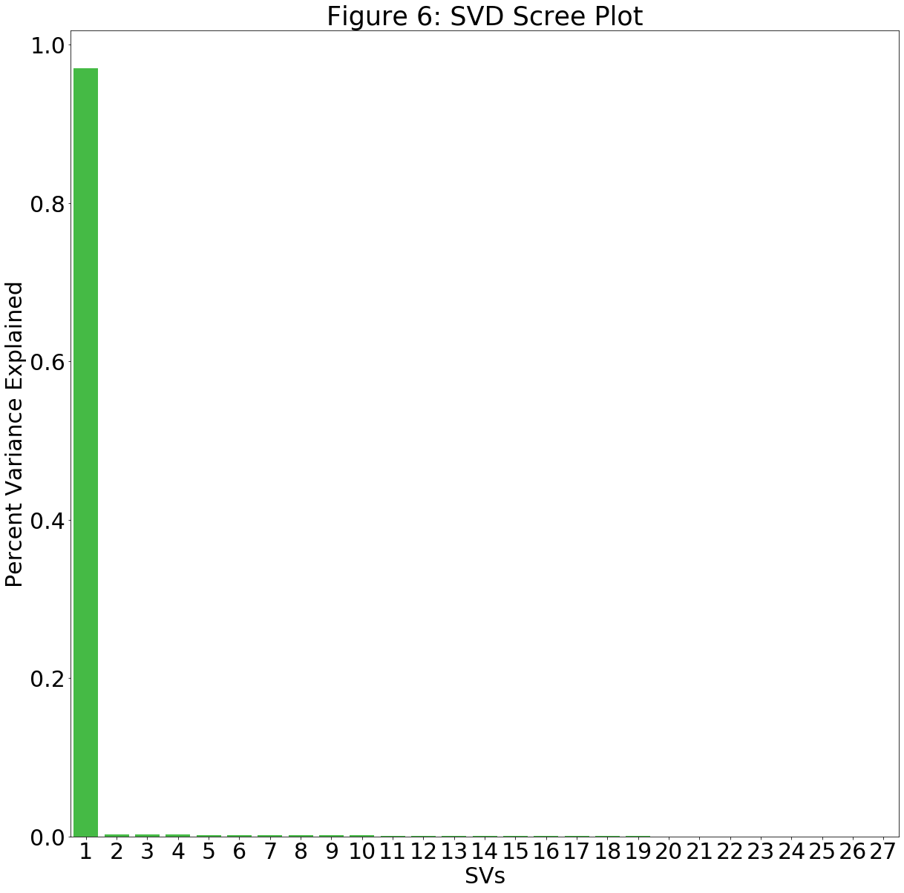

Slide 16
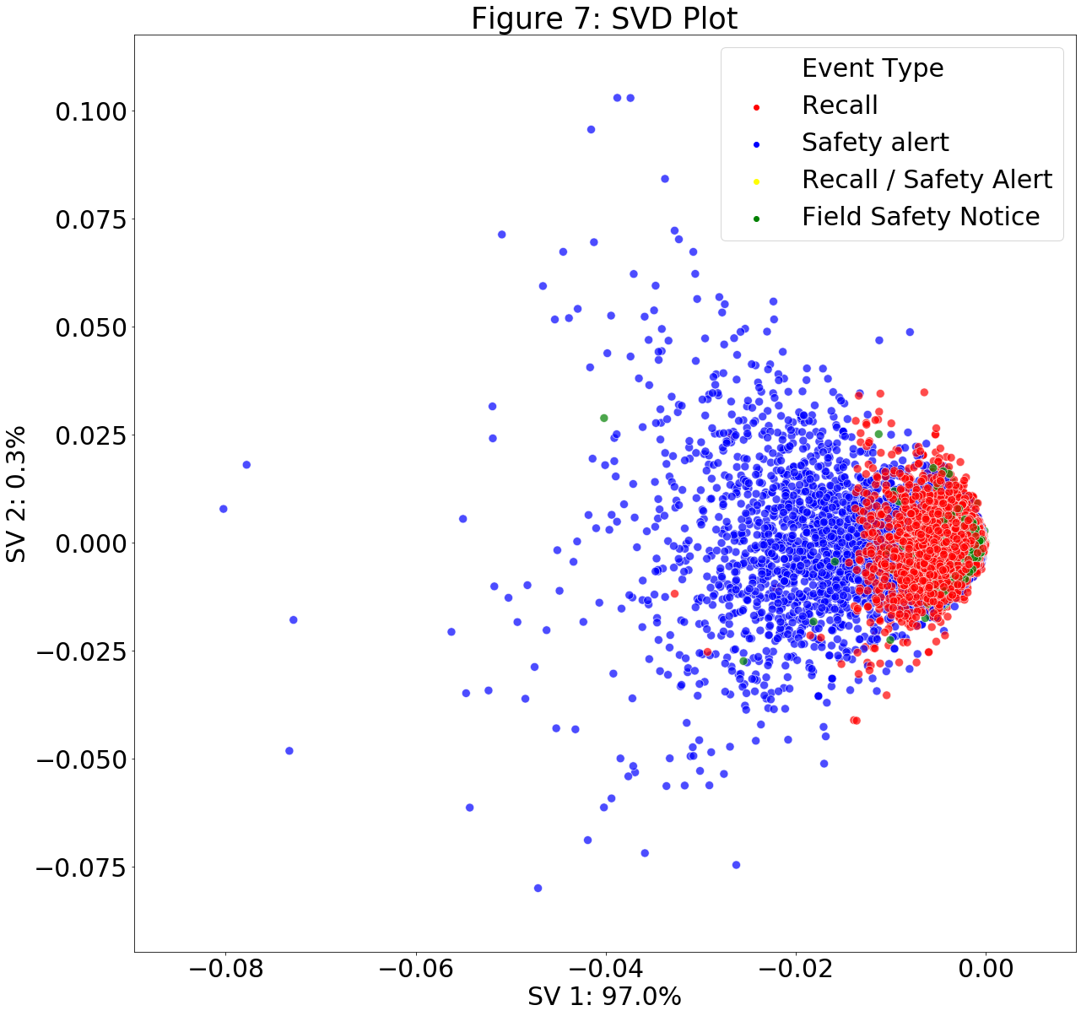

Slide 17
Statistical Inferences
K-Means clustering and SVD indicate the text under the clean_reason column lack any distinct classifications.
K-fold cross validation and a multi-label classification method might improve the classification of the text data in the clean_reason column in the df_final dataset

Slide 18
In-Depth Analysis to create NLP Prediction Model
Utilized multi-label classification in NLP to create prediction model
Text data and target variable needed to be converted into features and formats respectively.
Text Data: clean_reason column of df_final.csv
Target Variable: type column of df_final.csv
Ensured model’s performance with k-fold cross validation
Resampling technique that evaluates machine learning models on limited data
Used over simple train/test split due to generally having less biased or less optimistic estimate of model’s performance

Slide 19
K-Fold Cross Validation
Works by randomly dividing the set of the data’s observations into approximately equal-sized k groups, or folds
First fold treated as the validation (test) set
Method fitted on the remaining k − 1 folds (training set)

Slide 20
Preparing df_final dataset for k-fold cross validation
data = df_final[['clean_reason', 'type']].copy() data = data.rename(columns={'clean_reason': 'text', 'type': 'class'}) #rename the columns in data data = data.reindex(np.random.permutation(data.index))

Slide 21
Extracting Features and Classifying the Corpus
pipeline = Pipeline([ ('vectorizer', CountVectorizer(ngram_range=(1, 2))), #extract more features from the text by implementing bigram (2-grams) counts ('classifier', MultinomialNB())])

Slide 22
Performing k-fold cross-validation
k_fold = KFold(n_splits=10, shuffle=False, random_state=None) #set 10 folds to the cross-validation scores = [] for train_indices, test_indices in k_fold.split(data): train_text = np.asarray(data.iloc[train_indices]['text']) train_y = np.asarray(data.iloc[train_indices]['class']) test_text = np.asarray(data.iloc[test_indices]['text']) test_y = np.asarray(data.iloc[test_indices]['class']) pipeline.fit(train_text, train_y) score = pipeline.score(test_text, test_y) scores.append(score) score = sum(scores) / len(scores)

Slide 23
Evaluating Accuracy of K-Fold Cross Validation
score
0.94851247432078
Score method in the k-fold cross validation calculates the mean accuracies of each fold which are then averaged together for a mean accuracy of the entire k-fold cross validation set.
The calculated score indicates the train and test sets created from the k-fold cross validation are about 95% accurate overall.

Slide 24
train and test sets of the Corpus were converted into TF-IDF features
#Using TF-IDF to extract features from the cleaned version of the reason data tfidf_vectorizer = TfidfVectorizer(max_df=0.8, max_features=10000) # set 10,000 most frequent words in the data as features
#Create TF-IDF features xtrain_tfidf = tfidf_vectorizer.fit_transform(train_text) xval_tfidf = tfidf_vectorizer.transform(test_text)

Slide 25
Formatting train and test sets of target variable Via one-hot encoding by sklearn’s MultiLabelBinarizer function
#Convert train_y and test_y into datasets df_train_y=pd.DataFrame(train_y, columns=['new_type']) df_test_y=pd.DataFrame(test_y, columns=['new_type']) #Converting values in df_train_y and df_test_y into lists with ',' replacing '/' df_train_y['new_type'] = df_train_y['new_type'].str.split(' / ') df_test_y['new_type'] = df_test_y['new_type'].str.split(' / ')

Slide 26
Formatting train and test sets of target variable Via one-hot encoding by sklearn’s MultiLabelBinarizer function
#One hot encode the target variable, i.e., type by using sklearn’s MultiLabelBinarizer( ) multilabel_binarizer = MultiLabelBinarizer() multilabel_binarizer.fit(df_train_y['new_type']) multilabel_binarizer.fit(df_test_y['new_type'])
MultiLabelBinarizer(classes=None, sparse_output=False)
# transform target variable ytrain = multilabel_binarizer.transform(df_train_y['new_type']) yval = multilabel_binarizer.transform(df_test_y['new_type'])

Slide 27
Create the NLP prediction model
#Use sk-learn’s OneVsRestClassifier class to solve this problem as a Binary Relevance or one-vs-all problem lr = LogisticRegression() clf = OneVsRestClassifier(lr)
#Fit model on train data clf.fit(xtrain_tfidf, ytrain)
#Make predictions for validation set y_pred = clf.predict(xval_tfidf)

Slide 28
Checking a sample of the predictions
#Check out a sample from these predictions y_pred[3]
array([0, 1, 0])
#Convert the predicted arrays into event type tags multilabel_binarizer.inverse_transform(y_pred)[3]
('Recall',)

Slide 29
Evaluate NLP Prediction Model’s Performance
All of the predictions and the entire target variable of the validation set taken into consideration
F1 score, also known as balanced F-score or F-measure
Interpreted as a weighted average of the precision and recall
Ranges between 0 and 1 where 0 is worst score while 1 is best score
F1 = 2 x (precision x recall) / (precision + recall)
Average of each class with weighting depending on the average parameter in the multi-class and the multi-label case

Slide 30
Evaluate NLP Prediction Model’s Performance
# evaluate performance f1_score(yval, y_pred, average="micro")
0.9596819988642816
F1 score calculated to be about 0.96
NLP prediction model that was created in this project has nearly perfect precision and recall.

Slide 31
Creating an inference function
Take any text describing the reasons for a medical device being put under investigation as input and to give the predicted outcome of the negative event type(s) (Field Safety Notice, Recall, and/or Safety Alert) that would take place for the medical device

Slide 32
Format Target Variable from Main Dataset
The type column in the df_final dataset was split to convert the values in the column into individual lists which were stored into a new column called new_type.
#Create new_type column in df_final dataset df_final['new_type'] = df_final['type'].str.split(' / ')

Slide 33
Load text cleaning functions created in Capstone Project 1 Dataset - Final-Edited.ipynb
# function for text cleaning def clean_text(text): # remove everything except alphabets text = re.sub("[^a-zA-Z]"," ",text) # remove whitespaces text = ' '.join(text.split()) # convert text to lowercase text = text.lower() return text
# function for stemming words def stem_text(text): ps = PorterStemmer() token_words=word_tokenize(str(text)) token_words stem_text=[] for word in token_words: stem_text.append(ps.stem(word)) stem_text.append(" ") return "".join(stem_text)
# function to remove stopwords def remove_stopwords(text): stop_words = set(stopwords.words('english')) no_stopword_text = [w for w in str(text).split() if not w in stop_words] return ' '.join(no_stopword_text)

Slide 34
Create Inference Function
#Create inference function def infer_event(q): q = clean_text(q) q = stem_text(q) q = remove_stopwords(q) q_vec = tfidf_vectorizer.transform([q]) q_pred = clf.predict(q_vec) return multilabel_binarizer.inverse_transform(q_pred)

Slide 35
Display Results of Inference Function
for i in range(10): k = df_final['reason'].sample(1).index[0] print("Medical Device: ", df_final['device_name'][k], "\nPredicted Event Type: ", infer_event(df_final['reason'][k])), print("Actual Event Type: ",df_final['new_type'][k], "\n")

Slide 37
Potential Improvements to NLP Prediction Model
Might have limitations on medical text written in different languages other than English
Different grammatical structures for different languages
Different medical terminology and lingo between individual countries following different medical policies and systems
Possible to train this NLP prediction model to incorporate the different languages and medical terminology of different countries to classify the negative event types that might occur for the medical devices?

